Slide 1
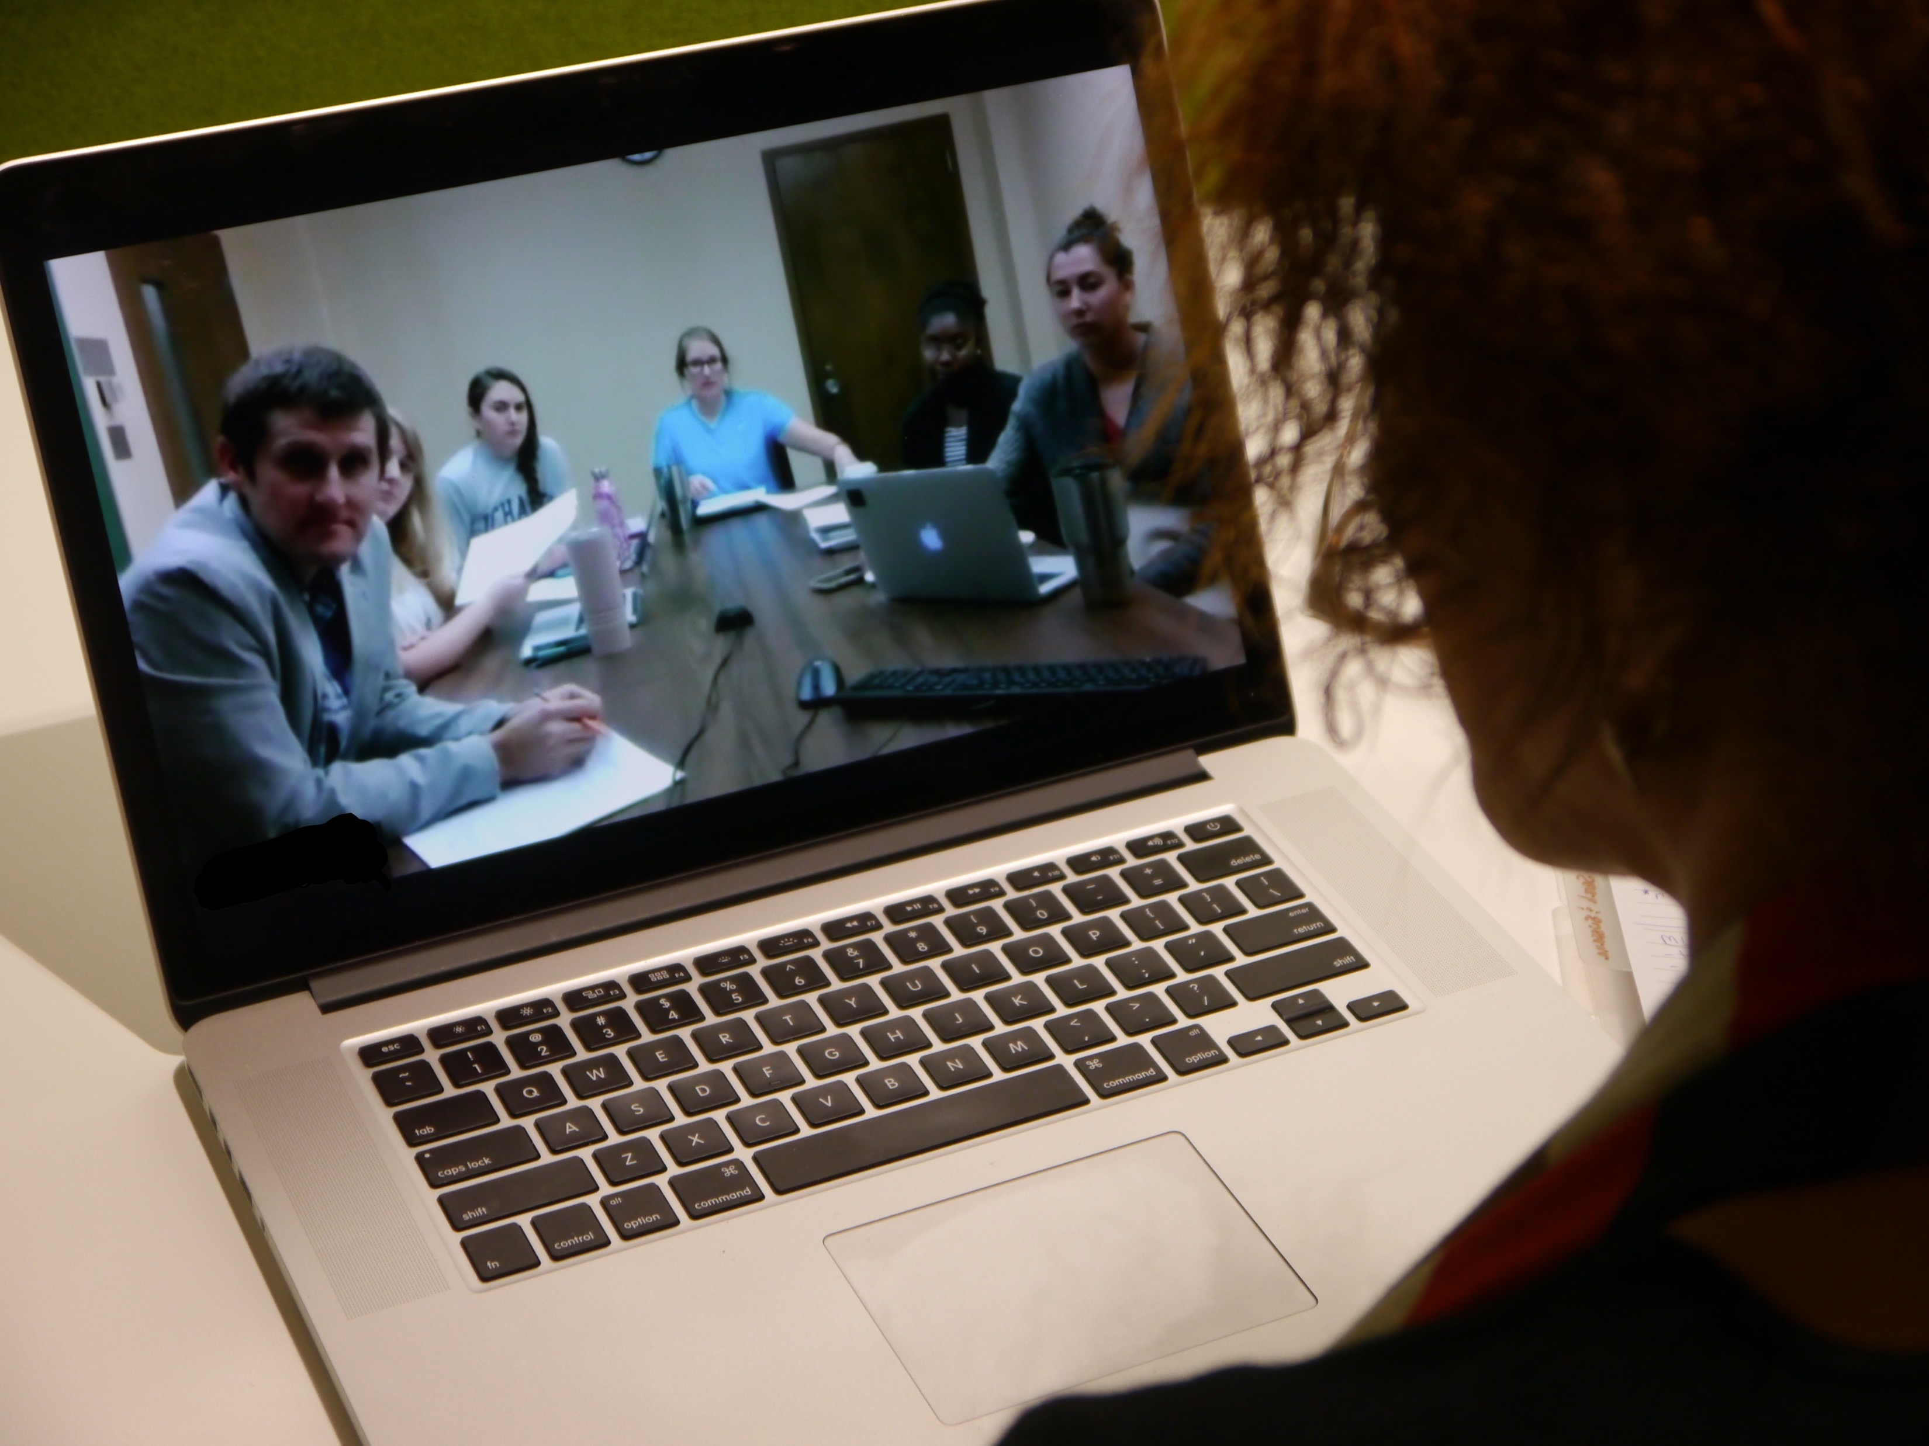
Janet Thompson Jackson Professor of Law Interim Co-Director, Washburn Law Clinic Director, Small Business and Nonprofit Transactional Clinic Visiting Professor, University of Groningen, Law Faculty The Netherlands
Lessons Learned (so far)
From Remote Clinical Teaching

Slide 2
Lessons Learned (so far)
Leverage what’s already been learned
Transparency = Comfort
Know and test your technology
Make your remote location a PLUS
Get feedback early and often
Anticipate failure, and capitalize on it!
Time zones are real

Slide 3
Leverage what’s already been learned
Who had done it before?
Who has researched or written about it?
What rules/guidelines need to be followed?

Slide 4
Transparency = Comfort
Comfort levels rise with increased transparency
Let your students know what to expect in advance
Provide anonymous and face-to-face opportunities for questions and concerns
Be open about trial and error process

Slide 5
Know and test your technology
Develop excellent rapport with IT staff
Schedule in-person or online training sessions with IT staff for yourself and your students
Adopt the attitude that no IT questions is a stupid question

Slide 6
Know and test your technology
Test multiple platforms
Have back-up platforms ready when something goes wrong at the last minute
Be open to changing technology midstream

Slide 7
Know and test your technology
Technology will fail – have a backup plan
Use messaging function of video platform if audio is not working
Use audio alone if video is not working
ALWAYS let IT staff know when you will be online for class, supervision, or other meetings so that they are on call

Slide 8
Make your remote location a PLUS
Tell your students stories about your experience
Post pictures and videos for students and colleagues to see
Include guest appearances from local professors, practitioners and students, if possible
Skype or Zoom your students into your local classroom, if possible
Learn from local professors and programs

Slide 9
Get feedback early and often
Written
Face-to-Face
Survey Monkey
Reflections
Mid-term and Semester-end Evaluations
Use supervision as a way to probe students about comfort level of synchronous video meetings
Make sure students have easy access to other clinical faculty

Slide 10
Anticipate failure, and capitalize on it!
Use mishaps as teaching moments
Whether it’s a technology problem, a time zone mishap, or something else, put the focus on how you deal with the problem
Think about whether students were impacted differently because of the physical distance and respond accordingly

Slide 11
Time zones are real
Set time boundaries and stick to them, except in emergencies
Clearly define emergencies
Be realistic about your level of engagement when it’s the end of your day and the beginning of your student’s day
Be willing to change your daily routine

Slide 12
Contact Information:
Janet Thompson Jackson
Janet.Jackson@washburn.edu
J.Jackson@rug.nl
+31 06 57845693
I’m on:
What’sApp
Skype
Zoom
Facebook
LinkedIn

